Slide 1
Introduction to
Artificial Intelligence
Lecture: Bayesian Networks

Slide 2
Outline
Representing Knowledge in an Uncertain Domain
Exact Inference in Bayesian Networks
Constructing Bayesian Networks

Slide 3
Full joint probability distribution
The full joint probability distribution (JPD) can answer any question about the domain.
(Conditional) independence relationships among variables can greatly reduce the number of probabilities required.
Bayesian networks can represent essentially, and in many cases very concisely, any full JPD.
Belief network, probabilistic network, causal network, knowledge map

Slide 4
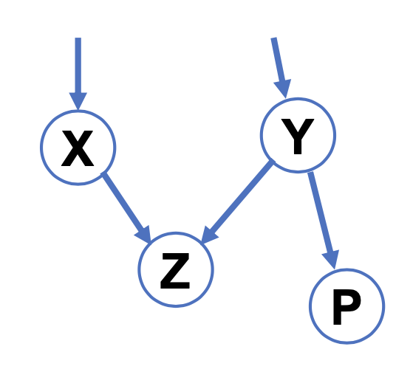
Bayesian networks
A Bayesian network is a directed graph in which each node is annotated with quantitative probability information.
Each node presents a random discrete/continuous variable.
A set of directed links or arrows connects pairs of nodes.
Each node 𝑋_{i} has a probability distribution 𝑷(𝑋_{i} | 𝑃𝑎𝑟𝑒𝑛𝑡(𝑋_{i} )) that quantifies the effect of the parents on the node.
DAG
X and Y are parents of Z
Y is the parent of P

Slide 5
Bayesian network topology
The network topology defines the conditional independence relationships that hold in the domain.
An arrow means that 𝑋 has a direct influence on 𝑌, which suggests that causes should be parents of effects.
A domain expert decides what direct influences exist.
Then, specify a conditional probability distribution for each variable, given its parents.

Slide 6
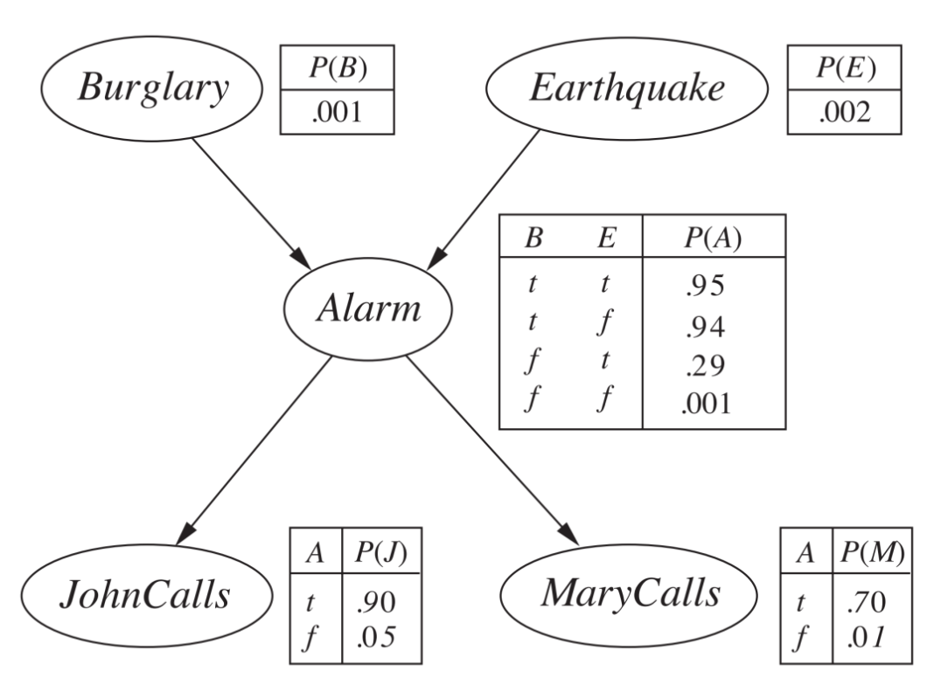
BM Example
Burglary and earthquakes directly affect the probability of the alarm’s going off
Whether John and Mary call depends only on the alarm.

Slide 7
Conditional probability table (CPT)
The probabilities summarizes a potentially infinite set of circumstances in which an event does (not) happen.
In this way, a small agent can cope with a very large world, at least approximately.
The probabilities summarizes a potentially infinite set of circumstances in which an event does (not) happen.
In this way, a small agent can cope with a very large world, at least approximately.

Slide 8
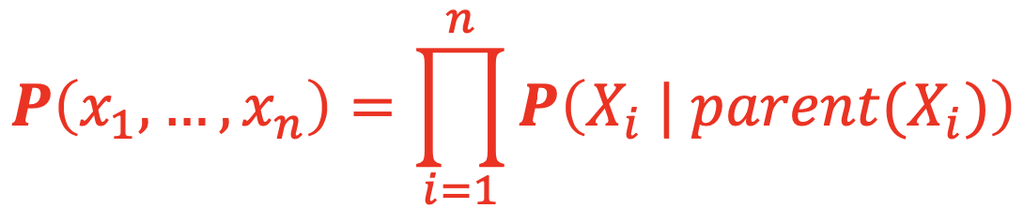
Represent the full joint distribution
An entry in the joint distribution is the probability of a variable assignment, such as 𝑷(𝑋₁ = 𝑥₁ ∧⋯∧ 𝑋_{n} = 𝑥_{n}).
Thus, it is the product of the appropriate elements of the CPTs in the Bayesian network.

Slide 9
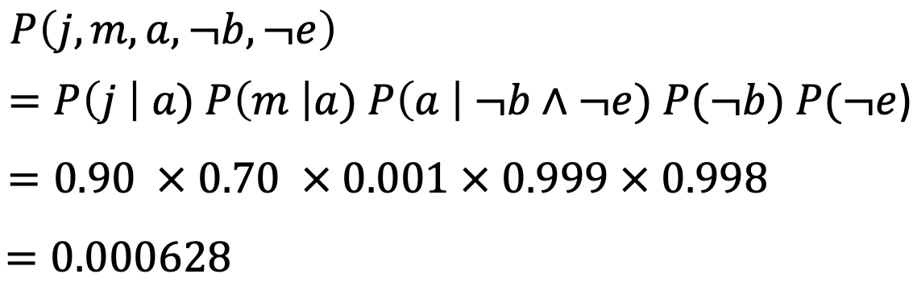
Represent the full joint distribution

Slide 10
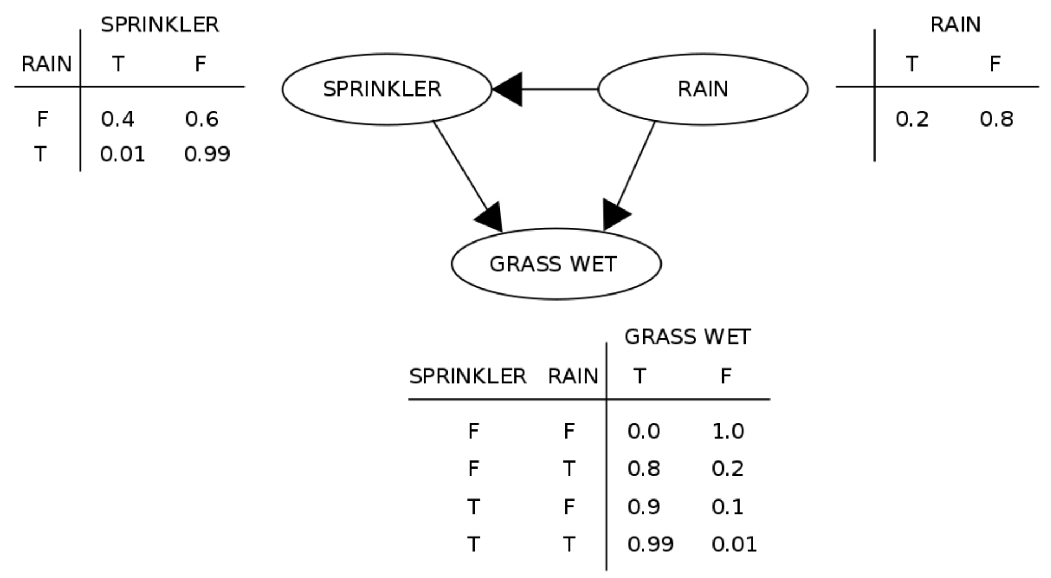
Represent the full joint distribution

Slide 11
Notations
𝑋 denotes the query variable.
𝑬 denotes the set of evidence variables 𝐸₁,..., 𝐸_{m}, and 𝒆 is a particular observed event.
𝑌 denotes the non-evidence, non-query variables 𝑌₁,... , 𝑌_{n} (called the hidden variables).
Thus, the complete set of variables is 𝑿 = {𝑋} ∪ 𝐸 ∪ 𝑌.
A typical query asks for the posterior probability 𝑷(𝑋 | 𝒆)

Slide 12
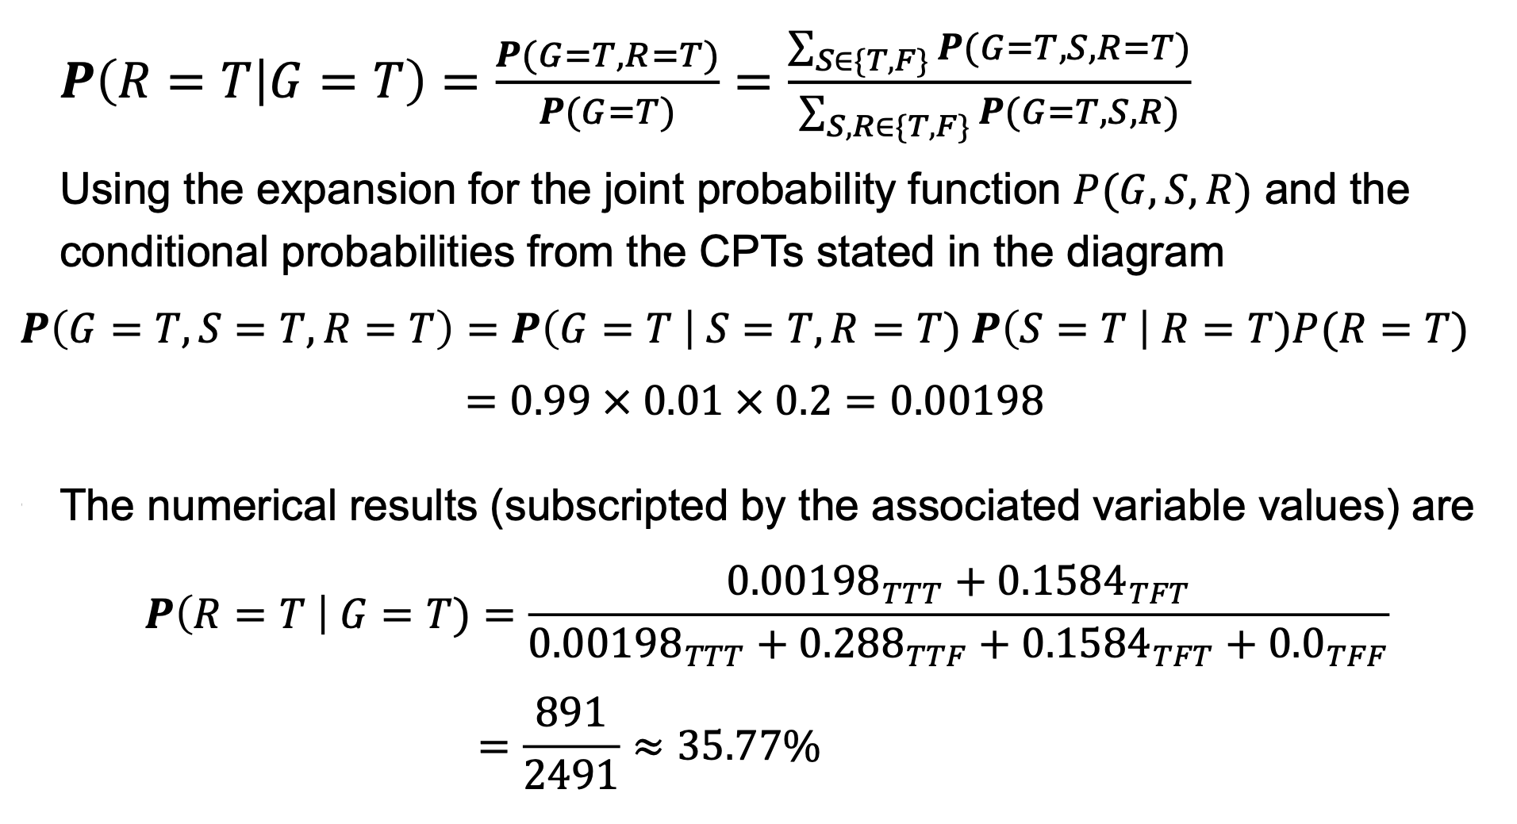
Represent the full joint distribution

Slide 13
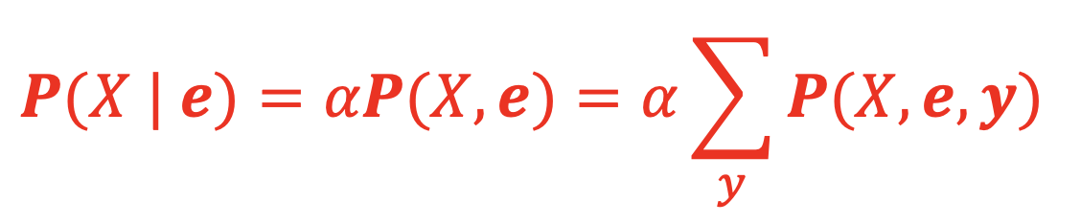
Inference by enumeration
A query can be answered by computing sums of products of conditional probabilities from the Bayesian network.
where 𝛼 stands for the constant denominator term, which is usually simplified during calculation.

Slide 14
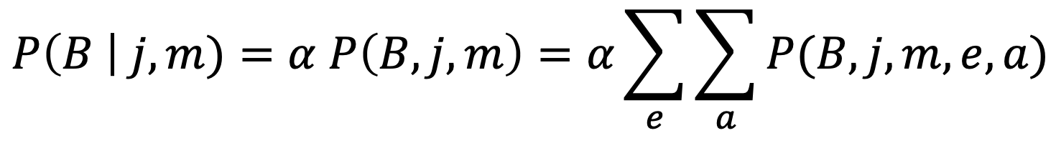
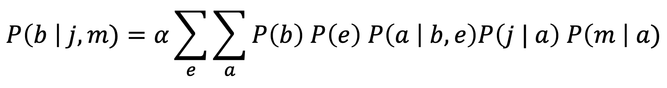
Inference by enumeration
Consider the following query
The hidden variables are 𝐸𝑎𝑟th𝑞𝑢𝑎𝑘𝑒 and 𝐴𝑙𝑎𝑟𝑚.
Using initial letters for the variables, we have
For simplicity, we do this for 𝐵𝑢𝑟𝑔𝑙𝑎𝑟𝑦 = 𝑡𝑟𝑢𝑒.
Complexity: 𝑶(𝒏𝟐^{𝒏}) for a network with 𝑛 Boolean variables

Slide 15
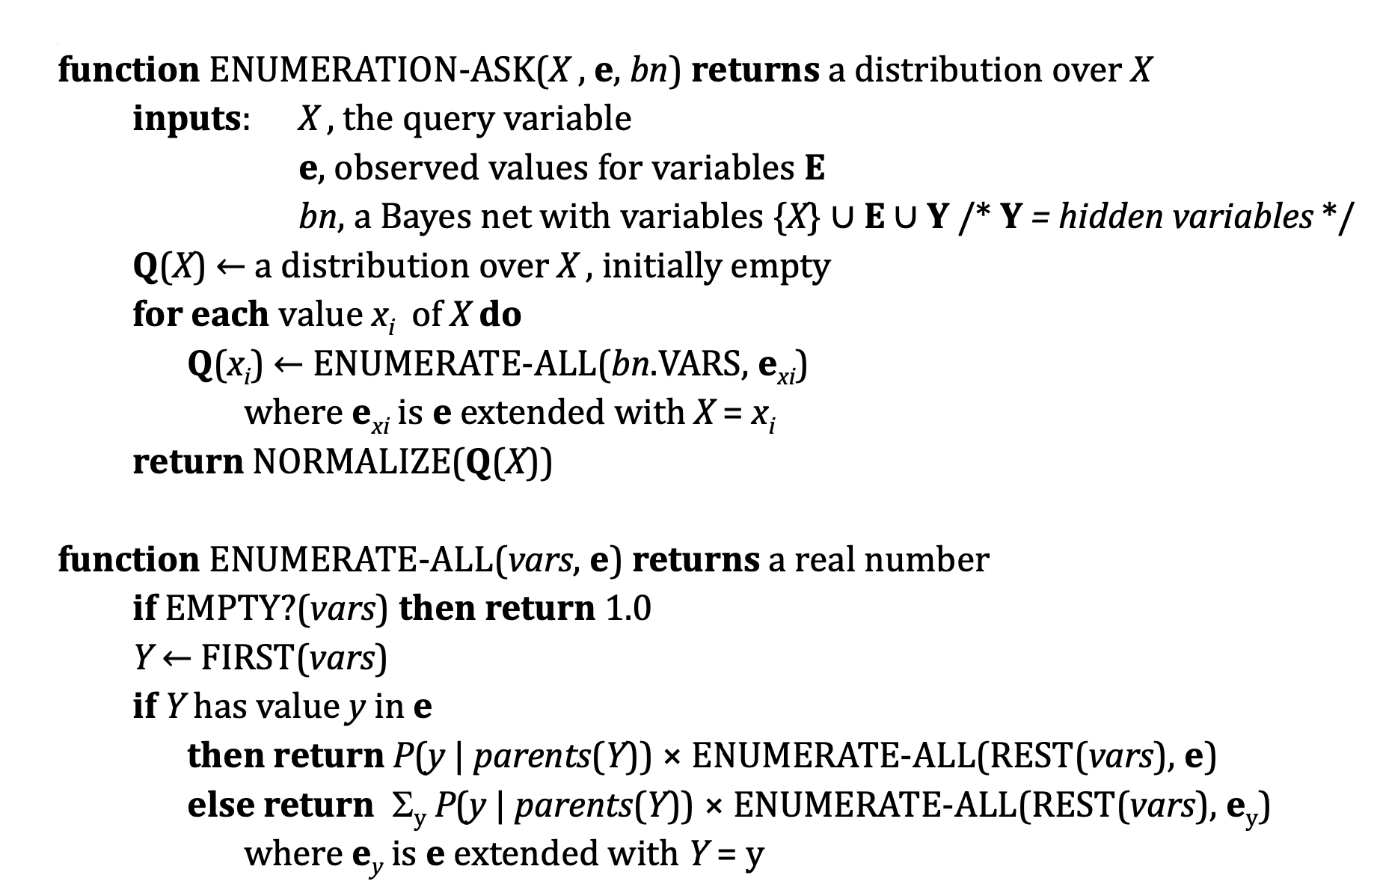
Inference by enumeration

Slide 16
Construct a Bayesian network
Scenario 1: Network structure known and all variables observable
Compute only the CPT entries
Scenario 2: Network structure known while some variables hidden
Gradient descent (greedy hill-climbing) method, i.e., search for a solution along the steepest descent of a criterion function
Scenario 3: Network structure unknown, all variables observable
Search through the model space to reconstruct network topology
Scenario 4: Network structure unknown and all variables hidden
No good algorithms known for this purpose

Slide 17
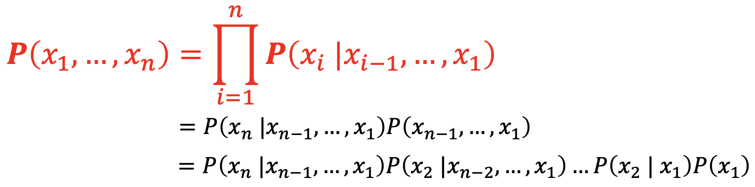
Construct a Bayesian network
The Chain Rule holds for any set of random variables.
We generally assert that, for every variable 𝑋_{i} in the network

Slide 18
Construct a Bayesian network
Each node must be conditionally independent of its other predecessors in the node ordering, given its parents.
Nodes: Identify the set of variables required to model the domain and order them {X₁,..., X_{n}}.
Links: For 𝑖 = 1 to 𝑛 do
Choose, from {𝑋₁,...,𝑋_{i-1}}, a minimal set of parents for 𝑋 such that Equation (*) is satisfied.
For each parent insert a link from the parent to 𝑋_{𝑖}.
CPTs: Write down the conditional probability table,
𝑃(𝑋_{𝑖}|𝑃𝑎𝑟𝑒𝑛𝑡(𝑋_{𝑖}))
Intuitively, the parents of node 𝑋_{i} should contain all those nodes in {𝑋₁,..., 𝑋_{i-1}} that directly influence 𝑋_{i}.

Slide 19
Construct a Bayesian network
The network is guaranteed to be acyclic.
Each node is connected only to earlier nodes.
Bayesian networks contain no redundant probability values.
If there is no redundancy, then there is no chance for inconsistency.
It is impossible for the domain expert to create a Bayesian network that violates the axioms of probability.

Slide 20
Example
You want to diagnose whether there is a fire in a building
You can receive reports (possibly noisy) about whether everyone is leaving the building.
If everyone is leaving, this may have been caused by a fire alarm.
If there is a fire alarm, it may have been caused by a fire or by tampering.
If there is a fire, there may be smoke.

Slide 21
Example
Start by choosing the random Boolean variables for this domain
𝑇𝑎𝑚𝑝𝑒𝑟𝑖𝑛𝑔 𝑇 : the alarm has been tampered with
𝐹𝑖𝑟𝑒 (𝐹): there is a fire
𝐴𝑙𝑎𝑟𝑚 (𝐴): there is an alarm
𝑆𝑚𝑜𝑘𝑒 (𝑆): there is smoke
𝐿𝑒𝑎𝑣𝑖𝑛𝑔 (𝐿): there are lots of people leaving the building
𝑅𝑒𝑝𝑜𝑟𝑡 (𝑅): the sensor reports that everyone are leaving the building.

Slide 22
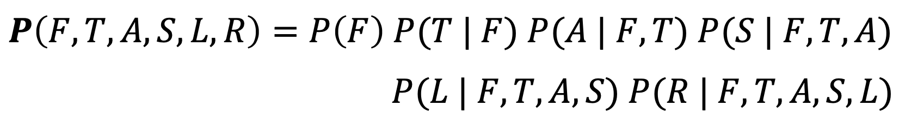
Example
Define a total ordering of variables
Choose an order that follows the causal sequence of events
Fire (F) Tampering (T) Alarm (A) Smoke (S) Leaving (L) Report (R)
Consider the following chain rule and use given clues to simplify it

Slide 23
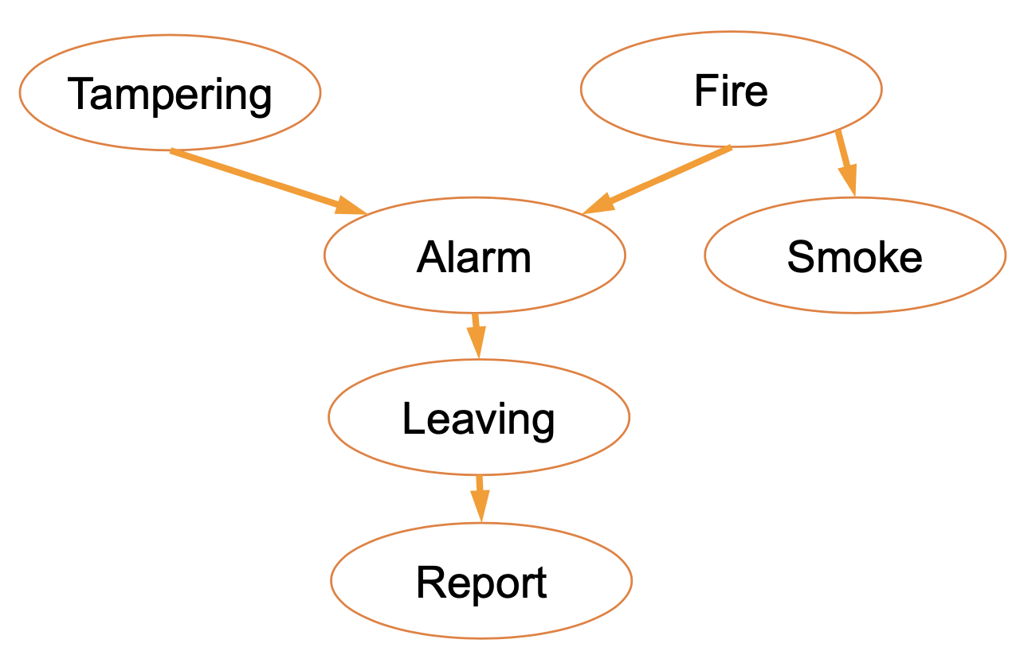
Example

Slide 24
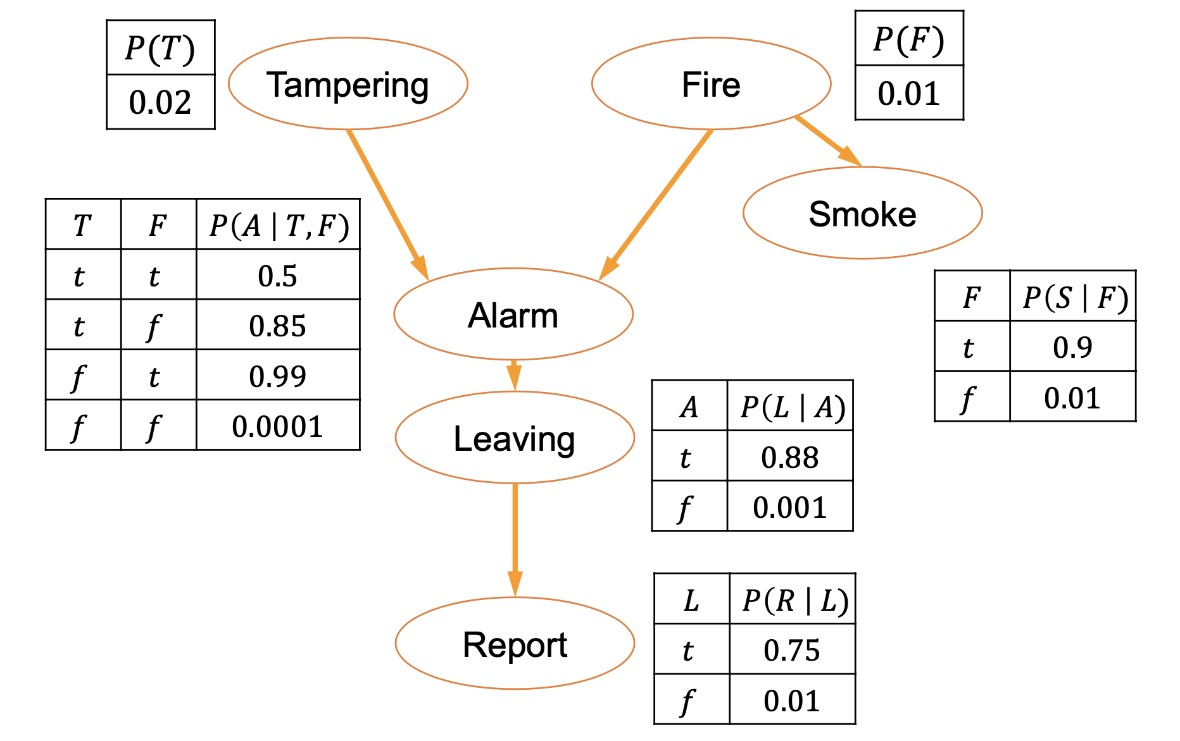
Example

Slide 25
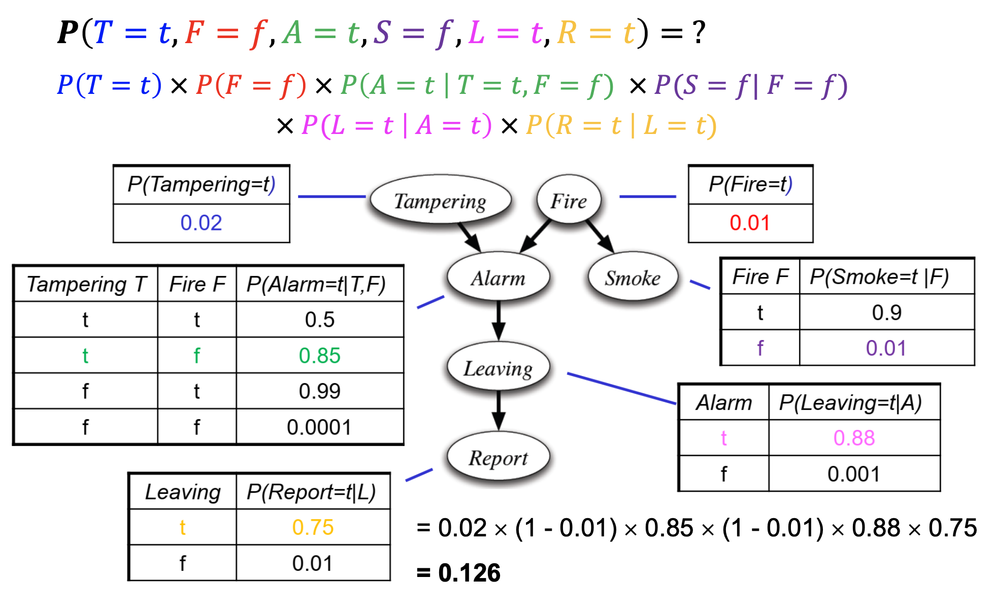
Example

Slide 26
Example

Slide 27
References
Stuart Russell and Peter Norvig. 2009. Artificial Intelligence: A Modern Approach (3rd ed.). Prentice Hall Press, Upper Saddle River, NJ, USA.
Lê Hoài Bắc, Tô Hoài Việt. 2014. Giáo trình Cơ sở Trí tuệ nhân tạo. Khoa Công nghệ Thông tin. Trường ĐH Khoa học Tự nhiên, ĐHQG-HCM.
Nguyễn Ngọc Thảo, Nguyễn Hải Minh. 2020. Bài giảng Cơ sở Trí tuệ Nhân tạo. Khoa Công nghệ Thông tin. Trường ĐH Khoa học Tự nhiên, ĐHQG-HCM.

